Slide 1
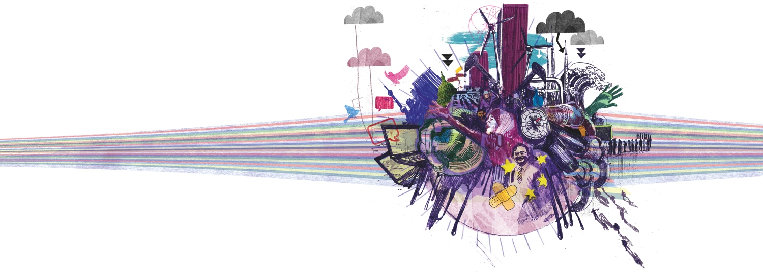
The global economy in 2012: a rocky road to recovery
Grant Thornton International Business Report

Slide 2
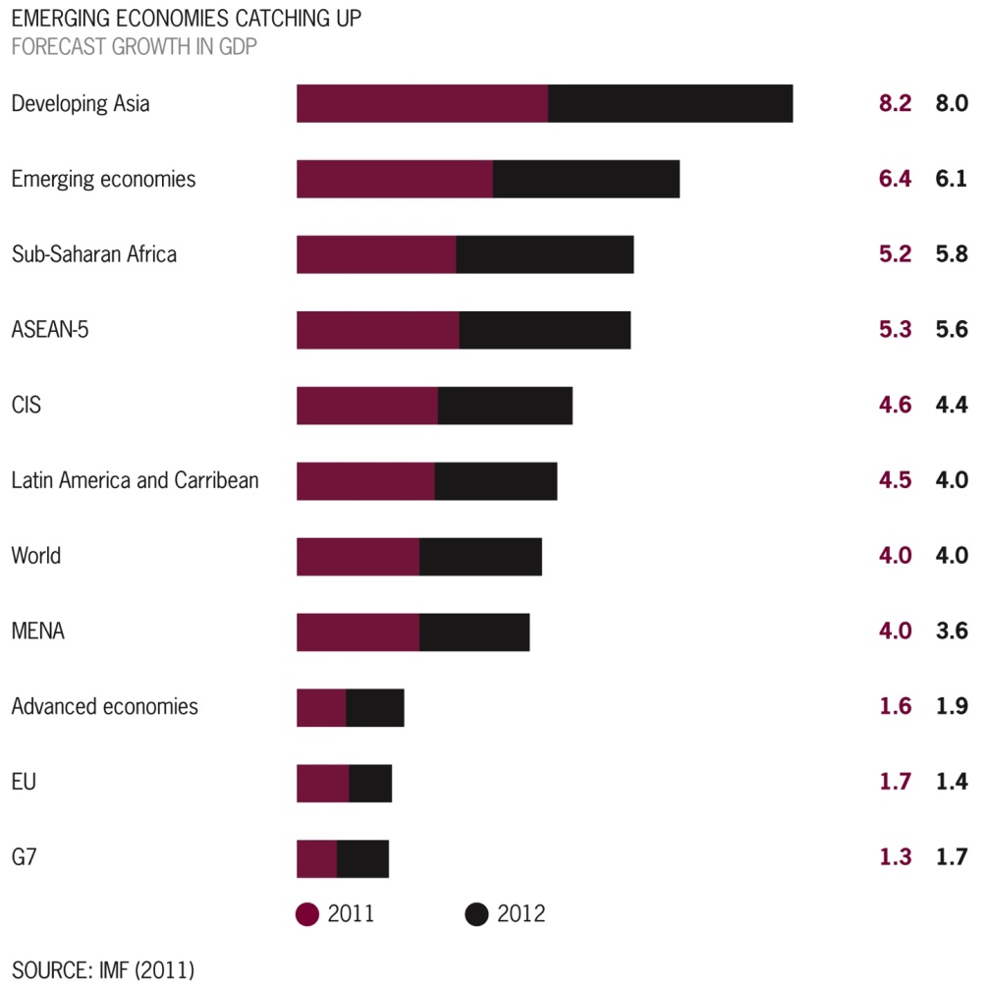
The year ahead
recovery from financial crisis remains uncertain
growth prospects in mature markets look weak
emerging markets expected to drive the global economy
shift in economic power from 'west to east' is speeding up.

Slide 3
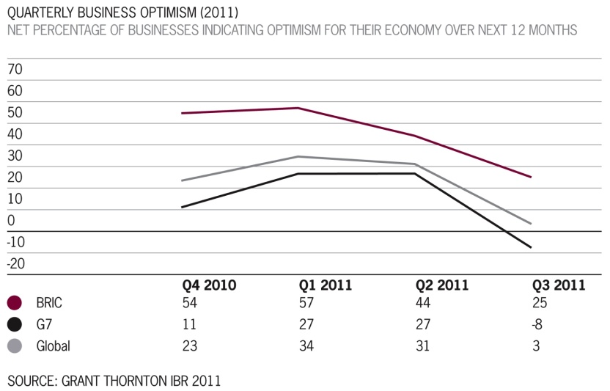
Business confidence
business confidence for the year ahead strong at the start of 2011, led by buoyant Latin America
in Q1, mature economies began to catch up but political, economic and natural unrest saw optimism slide in Q2
by Q3 optimism had fallen to net 3% - its lowest since 2009.

Slide 4
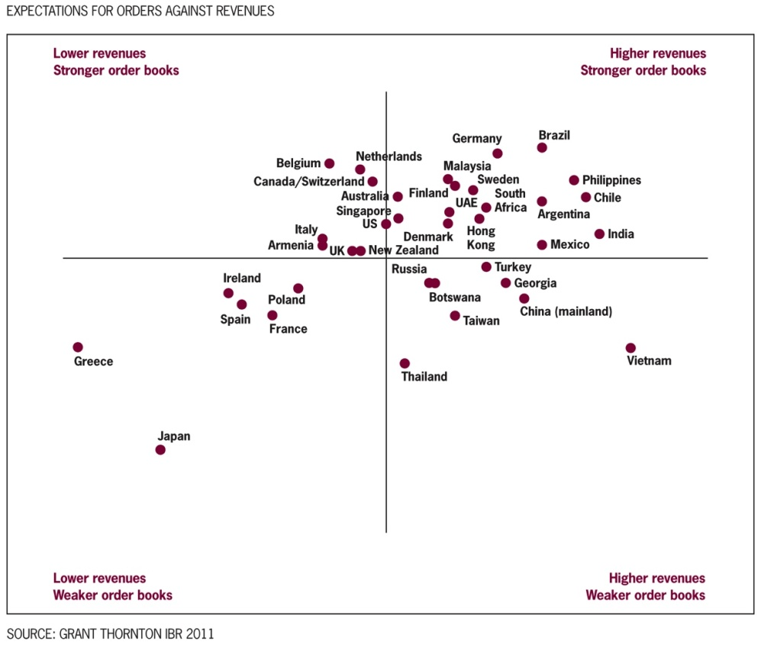
Business operations
expectations for revenues and profits rebounded strongly from 2010
but expectations fell in Q3, with more businesses citing a shortage of orders/ reduced demand
bureaucracy an increasing constraint in emerging markets.

Slide 5
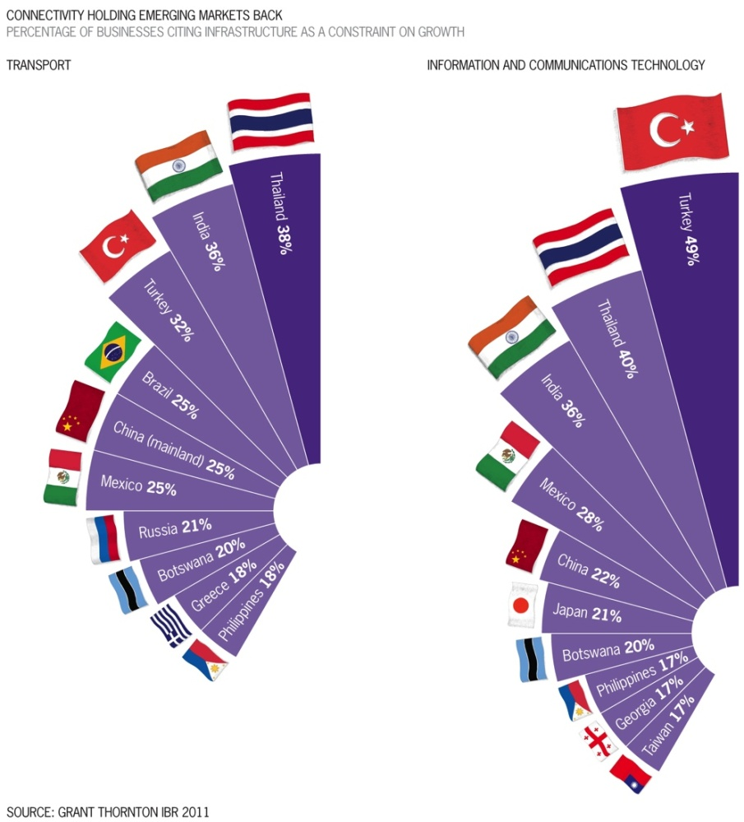
Investment
expectations for investment in plant & machinery and buildings rose, but fell for R&D
plans for investment in emerging markets remain robust
inadequate ICT and transport infrastructure holding businesses in emerging markets back.

Slide 6
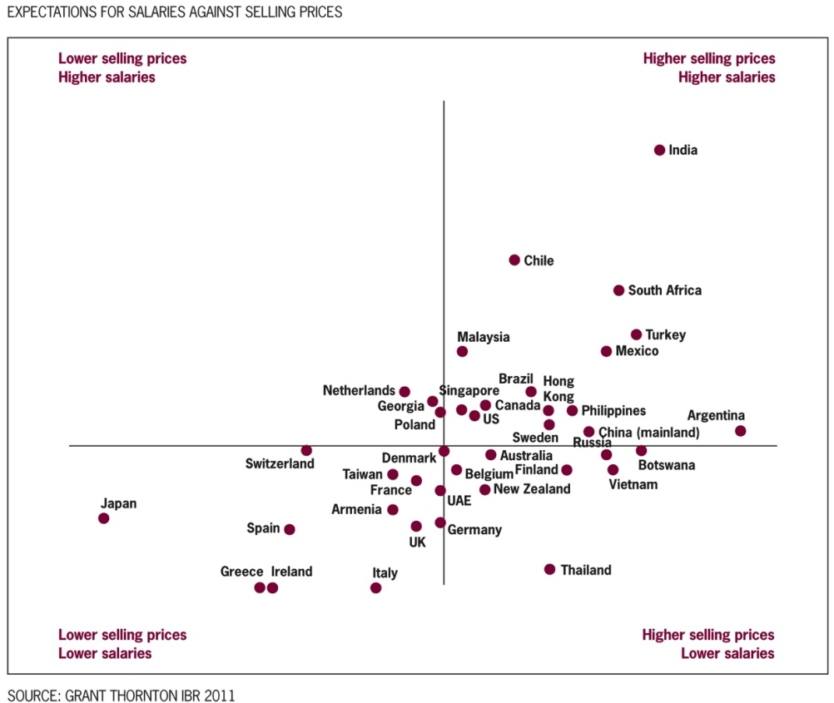
Inflation
loose monetary policy and high commodity prices increasing inflationary pressures
percentage of businesses expecting to raise prices over next 12 months has risen
improved salary expectations, although few businesses expect to offer above inflation increases.

Slide 7
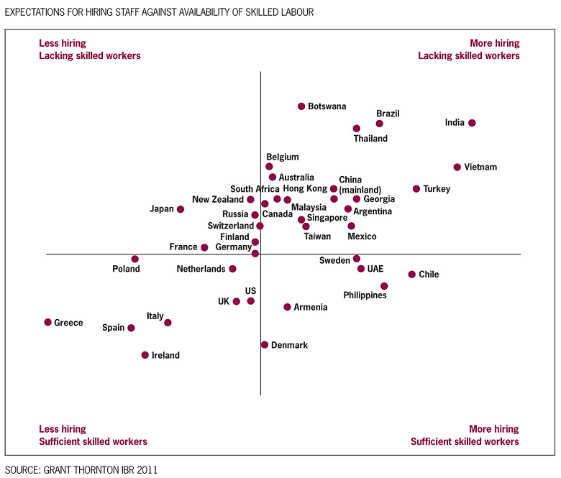
Employment
hiring expectations improved from 2010, particularly in emerging markets
Q3 results point to a tightening in labour markets
lack of skilled workers dampening business growth prospects in emerging markets.

Slide 8
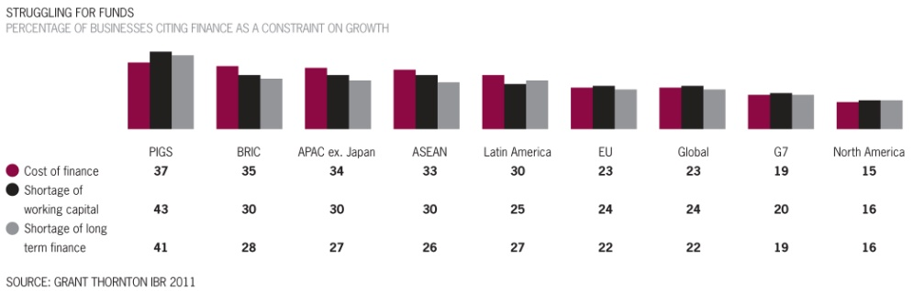
Access to finance
financial constraints fell, following a sharp dip in 2010
financing businesses less of an issue in mature markets, excluding troubled eurozone
lender support generally strong, with three-quarters of businesses citing lenders as supportive.

Slide 9
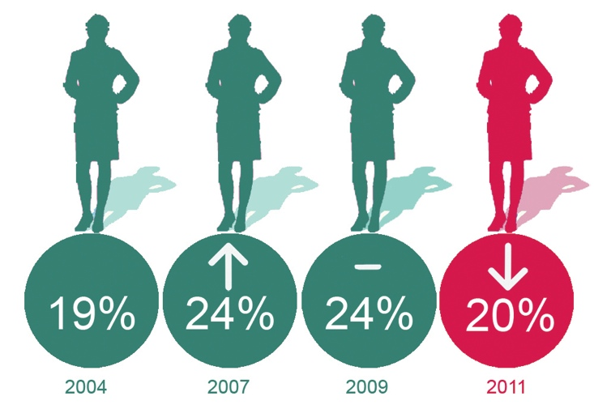
Topical issues
the full report also contains stories on:
  women in business
  corporate social responsibility
  Arab Spring
  renewable energy
  lease accounting
  social media.

Slide 10
More information
the full report is available on the IBR website
  internationalbusinessreport.com/reports/2011
for more information about IBR please contact Dominic King at GTIMarketing@gtinet.org

